Slide 1
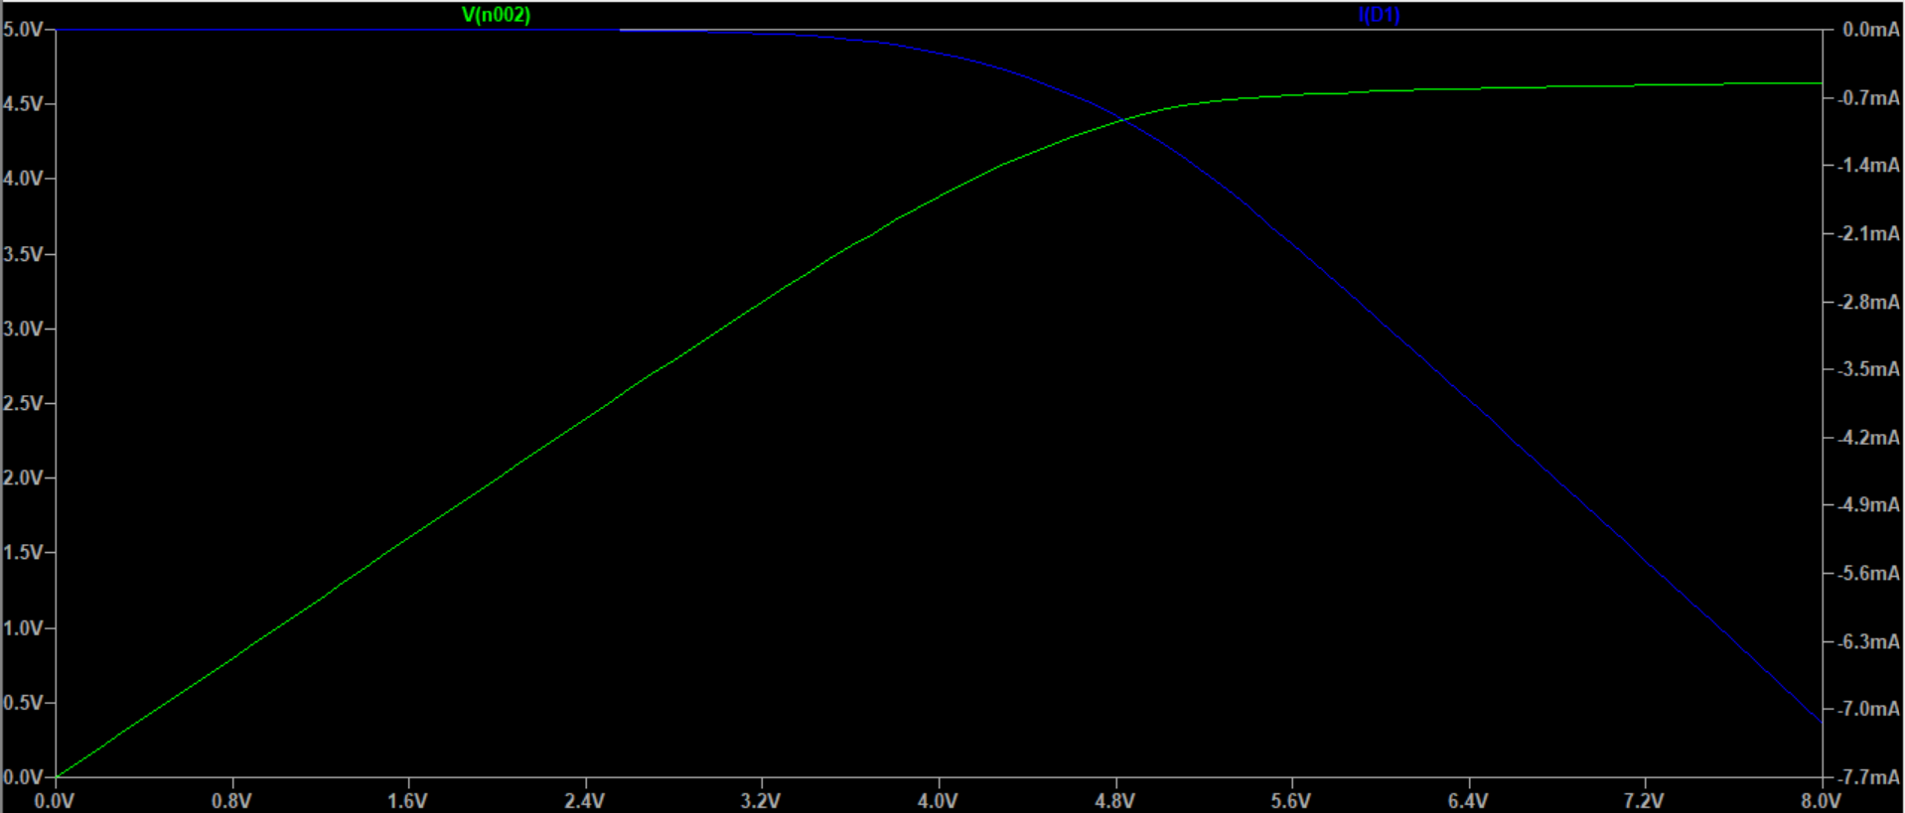
Exercise 5

Slide 2
Exercise 5
From the LTSpice graph, the breakdown voltage is approximately 2.264 V.
The current on the graph is negative, because (presumably) the positive direction for a diode is defined as anode – cathode in LTSpice.
Real life usages of the Zener diode should include ensuring the minimum voltage of a circuit. By connecting in series the Zener diode with the original circuit, the circuit will only be powered if the voltages are higher than a specific value.

